Slide 1
Clustered Decision Trees
Justin Lee and Abhinav Palikala

Slide 2
Introduction
Decision Trees: Classification model that’s used in several fields like Healthcare and Business.
Feature Selection: Traditional splitting heuristics like information gain, gain ratio, and Gini impurity act greedily, lacking the ability to optimize for future splits.
Research Focus: We address heuristic limitations with a novel algorithm, comparing its performance against existing methods across multiple datasets.
Novel Approach: The problem was tackled by combining K-means clustering to create “intuitive” groupings while also calculating the traditional entropy.

Slide 3
Related Work
The most common research on decision tree splitting is to alter the ‘purity’ or entropy measure
Traditional InfoGain
Gini impurity
Power-mean impurity
Generalized power series
None of these address our concerns for decision tree splitting
More “novel” methods combine several attributes together as part of a “multi-dimensional” selection method.
In a similar fashion, some splitting methods combine several different algorithms. This is where we decided to work.

Slide 4
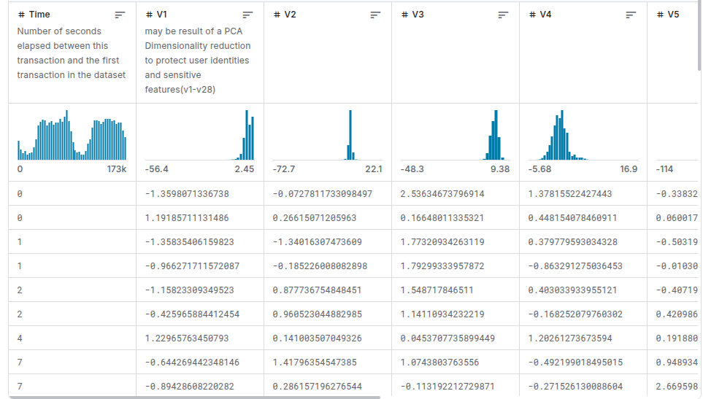
Dataset and Features
Credit Fraud Dataset
Heavily unbalanced dataset
492 frauds out of 284,8407 transactions (0.172% frauds)
30 feature attributes
Result of PCA on original dataset
Preprocessing
Choose a representative sample
Equal width 3 bins
Saved discrete and continuous data
80-20 split

Slide 5


Methods behind Clustered Decision Trees
Normal Decision Tree Heuristic:
Clustered Decision Tree Heuristic:
D: Node after split
K: K-Means cluster
C: Class label

Slide 6
Motivation
Consider the two following datasets:
Decision trees are greedy algorithms and only consider the instantaneous splitting power. These two datasets are thus treated the same.
Feature | Class
1 | 1
0 | 1
1 | 0
0 | 0
Feature | Class
1 | 1
1 | 1
0 | 0
0 | 0

Slide 7

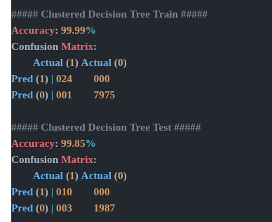
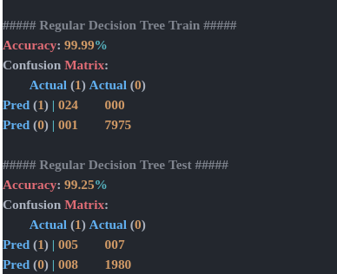
Results (K = 2)
Sensitivity = 10 / (10 + 3) = 0.769
Sensitivity = 5 / (5 + 8) = 0.385

Slide 8
Conclusion
Clustered Decision Trees do perform better than normal decision trees on select datasets
They are capable of capturing more complex interactions along with addressing unbalanced class labels
Significantly more computationally expensive than traditional decision trees

Slide 9
Future
Try to make it more efficient (cache clusters)
Weight different features differently
Compare the depths of decision trees to find if it makes cheaper (shallower) trees
Analyze the performance of CDTs on different data distributions

Slide 10
References
Bahnsen, A. C., Aouada, D., & Ottersten, B. (2015). Example-dependent cost-sensitive decision trees. arXiv preprint arXiv:1509.07266.
Breiman, L., Friedman, J., Olshen, R., & Stone, C. (2012). Classification and regression trees. Microsoft Research. Retrieved from https://www.microsoft.com/en-us/research/wp-content/uploads/2012/06/1206.4620.pdf
Dal Pozzolo, A., Caelen, O., Johnson, R. A., & Bontempi, G. (2015). Calibrating probability with undersampling for unbalanced classification. arXiv preprint arXiv:1511.08136.
Dugas-Phocion, G., & Bengio, S. (2020). Learning optimal decision trees using reinforcement learning heuristics. arXiv preprint arXiv:2010.08633.
Kaggle. (n.d.). Credit card fraud detection dataset. Retrieved from https://www.kaggle.com/datasets/mlg-ulb/creditcardfraud
Keylabs AI. (n.d.). Decision trees: How they work and practical examples. Retrieved from https://keylabs.ai/blog/decision-trees-how-they-work-and-practical-examples/
Lomax, S., & Vadera, S. (2013). A survey of cost-sensitive decision tree induction algorithms. Knowledge Engineering Review, 28(2), 159–188. Retrieved from https://pmc.ncbi.nlm.nih.gov/articles/PMC2701298/
Vation Ventures. (n.d.). Decision trees: Definition, explanation, and use cases. Retrieved from https://www.vationventures.com/glossary/decision-trees-definition-explanation-and-use-cases
Zhang, Y., & Wu, J. (2018). A survey on decision tree learning for heterogeneous data. arXiv preprint arXiv:1801.08310.

